Slide 1

Job & Joy Reconocimiento multimodal de emociones y estado de ánimo en trabajadores de oficina
Presentado por:
Ronald Fernando Rodríguez Barbosa

Slide 2

Tabla de Contenido
Factores de riesgo laboral (FRL)
Valoración y prevención FRP
Problemática
Propuesta Job & Joy
Metodología de desarrollo y evaluación
Otros dominios de aplicación J&J

Slide 3
Factores de riesgo laboral

Slide 4
Factores de riesgo laboral
Causas que pueden ser responsables de una enfermedad, lesión o daño, como consecuencia de la actividad que se realiza o el medio en el cual se permanece durante el desempeño de la actividad[].
Físico
Ruido, Iluminación o temperatura del entorno.
Químico
Contacto con productos químicos abrasivos.
Biológico
Hongos, bacterias o virus.
Mecánico
Uso de maquinaría pesada
Exposición a vibración.
Ambiental
Inundaciones o tormentas.
Contaminación

Slide 5
Factores de riesgo psicosocial (FRP)
Resolución 2646 de 2008:
Condiciones psicosociales cuya identificación y evaluación muestra efectos negativos en la salud de los trabajadores o en el trabajo[MINPRO2008].
Largas jornadas de trabajo | Dirección y supervisión inadecuado
Alta demanda de trabajo | Rol y responsabilidades ambiguos
Contextos físicos peligrosos | Falta de vinculación o participación
Matoneo | Acoso laboral

Slide 6
Efectos y consecuencias
Efectos en
Salud física
Espalda
Cuello
Brazos
Rodillas
Efectos en
Salud mental
Depresión
Estrés
Somnolencia
Fatiga mental
Emoción: Condiciones psicosociales cuya identificación y evaluación muestra efectos
Estado de ánimo: Condiciones psicosociales cuya identificación y evaluación muestra efectos.

Slide 7
9.653 casos
1.078 casos
165 personas
2017
de enfermedad de naturaleza laboral
de salud mental a nivel nacional
atendidas en las ciudad de bogotá
Información extraída de las bases de datos públicas del Mininisterio de Salud: www.minsalud.gov.co

Slide 9
Valoración y prevención de FRP

Slide 10
Técnicas y métodos convencionales
White
Is the color of milk and fresh snow, the color produced by the combination of all the colors of the visible spectrum.
Black
Is the color of coal, ebony, and of outer space. It is the darkest color, the result of the absence of or complete absorption of light.

Slide 11
Técnologías de apoyo e investigación
Sensores
Diagnósticos con EEG
Dispositivos móviles
Detección de posturas

Slide 12



Herramientas y servicios comerciales
White
Is the color of milk and fresh snow, the color produced by the combination of all the colors of the visible spectrum.

Slide 13
Problemática

Slide 14
Limitaciónes de adopción de soluciones tecnológicas
Costos
Tiempo de evaluación
Interrupción en actividades
Cesgo en la información

Slide 15
Aquí va la definición de los aspectos o características de la problematica a abordar con el proyecto de investigación.

Slide 16
Propuesta Job & Joy
Reconocimiento multimodal en video de emociones y estados de ánimo.

Slide 17
Objetivo general
Diseñar un sistema para la detección de poses y actividades relacionados con emociones y estados de ánimo de personas que trabajan en ambientes de oficina, orientado a brindar asistencia para la evaluación de consecuencias de factores de riesgo psicosocial, mediante y un enfoque multimodal y la captura de video por sistemas CCTV.

Slide 18
Objetivos específicos
Analizar a partir del estado del arte, las técnicas, modelos y herramientas actuales de identificación de poses y actividades relacionados con emociones de personas, a partir de imágenes de video, con el fin identificar y caracterizar las oportunidades potenciales de un sistema de detección y clasificación, con enfoque multimodal.
Diseñar una arquitectura multimodal, que integre la detección de expresiones faciales, posturas y acciones de una persona a partir de imágenes de video, para identificar y clasificar emociones y estados de ánimo.
Evaluar la precisión, el desempeño computacional y utilidad potencial del sistema propuesto, en la asistencia a la evaluación de consecuencias de factores de riesgo psicosocial, a través de su implementación parcial y puesta en operación controlada.

Slide 19
Contenido Mock ups
White
Is the color of milk and fresh snow, the color produced by the combination of all the colors of the visible spectrum.
Black
Is the color of coal, ebony, and of outer space. It is the darkest color, the result of the absence of or complete absorption of light.

Slide 20
Características principales
Yellow
Is the color of gold, butter and ripe lemons. In the spectrum of visible light, yellow is found between green and orange.
Blue
Is the colour of the clear sky and the deep sea. It is located between violet and green on the optical spectrum.
Red
Is the color of blood, and because of this it has historically been associated with sacrifice, danger and courage.
Yellow
Is the color of gold, butter and ripe lemons. In the spectrum of visible light, yellow is found between green and orange.
Blue
Is the colour of the clear sky and the deep sea. It is located between violet and green on the optical spectrum.
Red
Is the color of blood, and because of this it has historically been associated with sacrifice, danger and courage.

Slide 21
Utilidad en evaluación de consecuencias de FRP
Place your screenshot here
Show and explain your web, app or software projects using these gadget templates.

Slide 22
Notificación de riesgos potenciales
Place your screenshot here
Show and explain your web, app or software projects using these gadget templates.

Slide 23
Reportes de estadísticas
Place your screenshot here
Show and explain your web, app or software projects using these gadget
Resolución 2 templates.

Slide 24
Metodología

Slide 25
Etapas principales del proyecto
Investigación y análisis
Diseño del Sistema
Evaluación del sistema

Slide 26
Entregables
Etapa 1
Etapa 2
Etapa 3
Documento con las ecuaciones de búsqueda y estadísticas bibliográficas
Documento del diseño refinado de la arquitectura
Software de prototipo funcional.
Documento con especificación de requisitos del sistema
Documento del diseño detallado del sistema multi-agente
Copia de las autorizaciones de tratamiento de dato
Documento con la extracción, caracterización, evaluación y cuadro comparativo de herramientas y/o marcos de trabajo
Documento de caracterización del modelo de reconocimiento de emociones y estados de ánimo y los mecanismos de inteligencia artificial para clasificación
Documento de la validación experimental con los resultados de precisión, desempeño computacional y evaluación TAM
Artículo de la arquitectura y evaluación de la solución
Documento de artículo científico

Slide 27
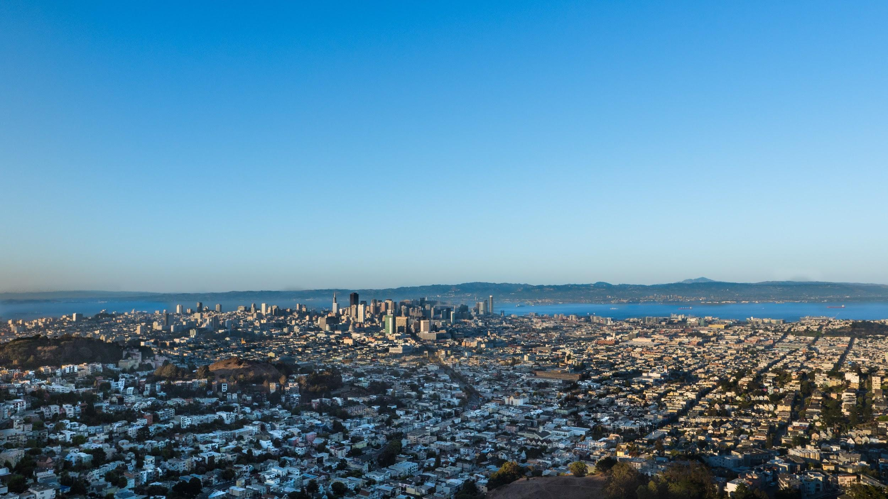
Otros Dominios de aplicación.

Slide 28
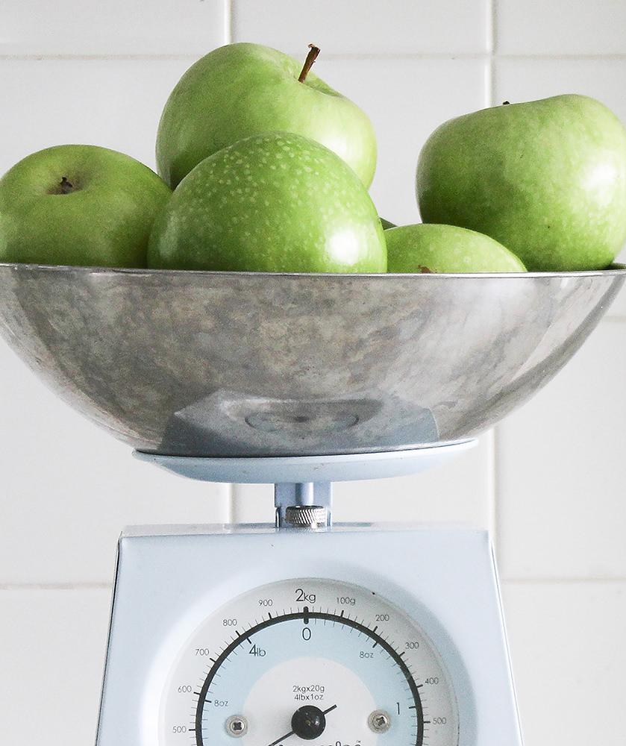
Detección de desórdenes alimenticios
A complex idea can be conveyed with just a single still image, namely making it possible to absorb large amounts of data quickly.

Slide 29
Detección de déficit de atención
A complex idea can be conveyed with just a single still image, namely making it possible to absorb large amounts of data quickly.

Slide 30
Detección de satisfacción de clientes
A complex idea can be conveyed with just a single still image, namely making it possible to absorb large amounts of data quickly.

Slide 31
Bibliografía
[1] Ministerio de la protección social, "Resolución 2646 de 2008," 2008.
[2] M. Rodríguez, "Factores Psicosociales de Riesgo Laboral: ¿Nuevos tiempos, nuevos riesgos?" Observatorio Laboral Revista Venezolana, vol. 2, (3), pp. 127-141, 2009. Available: http://dialnet.unirioja.es/servlet/oaiart?codigo=2995368.
[3] Raúl Mirza et al, "Occupational Noise-Induced Hearing Loss," Journal of Occupational and Environmental Medicine, vol. 60, (9), pp. e501, 2018. Available: https://www.ncbi.nlm.nih.gov/pubmed/30095587. DOI: 10.1097/JOM.0000000000001423.
[4] H. E. Landberg, H. Westberg and H. Tinnerberg, "Evaluation of risk assessment approaches of occupational chemical exposures based on models in comparison with measurements," Safety Science, vol. 109, pp. 412-420, 2018. Available: https://www.sciencedirect.com/science/article/pii/S0925753517315631. DOI: 10.1016/j.ssci.2018.06.006.
[5] C. R. N. CORRAO et al, "Biological Risk and Occupational Health," Industrial Health, vol. 50, (4), pp. 326-337, 2012. Available: https://jlc.jst.go.jp/DN/JALC/10007643537?from=SUMMON. DOI: 10.2486/indhealth.MS1324.
[6] P. Nataletti et al, "Occupational Exposure to Mechanical Vibration: The Italian Vibration Database for Risk Assessment," International Journal of Occupational Safety and Ergonomics, vol. 14, (4), pp. 379-386, 2008. Available: http://www.tandfonline.com/doi/abs/10.1080/10803548.2008.11076775. DOI: 10.1080/10803548.2008.11076775.
[7] E. G. Marshall et al, "Work-Related Unintentional Injuries Associated With Hurricane Sandy in New Jersey," Disaster Medicine and Public Health Preparedness, vol. 10, (3), pp. 394-404, 2016. Available: https://www-cambridge-org.ezproxy.javeriana.edu.co/core/article/workrelated-unintentional-injuries-associated-with-hurricane-sandy-in-new-jersey/AB0220A1F1E274EA41B0C2A33D0F2DCB. DOI: 10.1017/dmp.2016.47.
[8] V. Forastieri, "Psychosocial risks and work-related stress," Jul, 2013.
[9] Morales D. Diana, "Trabajo por turnos y presencia de obesidad en los trabajadores: Una revisión sistemática exploratoria," Jan 1, 2014.
[10] L. Wiegner et al, "Prevalence of perceived stress and associations to symptoms of exhaustion, depression and anxiety in a working age population seeking primary care - an observational study," BMC Family Practice, vol. 16, (1), pp. 38, 2015. Available: https://www.ncbi.nlm.nih.gov/pubmed/25880219. DOI: 10.1186/s12875-015-0252-7.
[11] M. Luca et al, "Prevalence of depression and its relationship with work characteristics in a sample of public workers," Neuropsychiatric Disease and Treatment, vol. 10, pp. 519-525, 2014. Available: https://www.ncbi.nlm.nih.gov/pubmed/24707177. DOI: 10.2147/NDT.S56989.
[12] Ministerio de salud, "Indicadores de riesgos laborales," Https://Www.Minsalud.Gov.Co, 2018.
[13] Ministerio de salud, "Observatorio Nacional de Salud Mental," Http://Onsaludmental.Minsalud.Gov.Co, 2019.

Slide 32
Bibliografía
[14] M. Labriola et al, "The impact of ergonomic work environment exposures on the risk of disability pension: Prospective results from DWECS/DREAM," Ergonomics, vol. 52, (11), pp. 1419-1422, 2009. Available: http://www.tandfonline.com/doi/abs/10.1080/00140130903067771. DOI: 10.1080/00140130903067771.
[15] J. A. Colmenares Pedraza and R. Herrera Medina, "Prevalencia de actividad física y beneficios y barreras en trabajadores de Villavicencio, Colombia," Revista De La Universidad Industrial De Santander. Salud, vol. 50, (1), pp. 37-45, 2018. . DOI: 10.18273/revsal.v50n1-2018004.
[16] Tage S Kristensen et al, "The Copenhagen Psychosocial Questionnaire-a tool for the assessment and improvement of the psychosocial work environment," Scandinavian Journal of Work, Environment & Health, vol. 31, (6), pp. 438-449, 2005. Available: https://www.jstor.org/stable/40967527. DOI: 10.5271/sjweh.948.
[17] J. A. Bauer and P. E. Spector, "Discrete Negative Emotions and Counterproductive Work Behavior," Human Performance, vol. 28, (4), pp. 307-331, 2015. Available: http://www.tandfonline.com/doi/abs/10.1080/08959285.2015.1021040. DOI: 10.1080/08959285.2015.1021040.
[18] K. Golonka et al, "Occupational burnout and its overlapping effect with depression and anxiety," International Journal of Occupational Medicine and Environmental Health, vol. 32, (2), pp. 229-244, 2019. Available: https://www.ncbi.nlm.nih.gov/pubmed/30855601. DOI: 10.13075/ijomeh.1896.01323.
[19] V. Putz-Anderson, B. P. Bernard and National Institute for Occupational Safety and Health, Musculoskeletal Disorders and Workplace Factors : A Critical Review of Epidemiologic Evidence for Work-Related Musculoskeletal Disorders of the Neck, Upper Extremity, and Low Back. 1997Available: http://hdl.handle.net/2027/uc1.31210011098603.
[20] S. Choi et al, "Risk Factor, Job Stress and Quality of Life in Workers With Lower Extremity Pain Who Use Video Display Terminals," Annals of Rehabilitation Medicine, vol. 42, (1), pp. 101-112, 2018. Available: https://www.ncbi.nlm.nih.gov/pubmed/29560330. DOI: 10.5535/arm.2018.42.1.101.
[21] Yong-Ren Huang and Xu-Feng Ouyang, "Sitting posture detection and recognition using force sensor," in Oct 2012, Available: https://ieeexplore.ieee.org/document/6513203. DOI: 10.1109/BMEI.2012.6513203.
[22] H. Jebelli, S. Hwang and S. Lee, "EEG-based workers' stress recognition at construction sites," Automation in Construction, vol. 93, pp. 315-324, 2018. Available: https://www.sciencedirect.com/science/article/pii/S092658051830013X. DOI: 10.1016/j.autcon.2018.05.027.
[23] Z. Zhu et al, "Naturalistic Recognition of Activities and Mood Using Wearable Electronics," T-Affc, vol. 7, (3), pp. 272-285, 2016. Available: https://ieeexplore.ieee.org/document/7299638. DOI: 10.1109/TAFFC.2015.2491927.
[24] C. R. Reid et al, "Wearable Technologies: How Will We Overcome Barriers to Enhance Worker Performance, Health, And Safety?" Proceedings of the Human Factors and Ergonomics Society Annual Meeting, vol. 61, (1), pp. 1026-1030, 2017. Available: https://journals.sagepub.com/doi/full/10.1177/1541931213601740. DOI: 10.1177/1541931213601740.

Slide 33
Bibliografía
[25] M. C. Schall, R. F. Sesek and L. A. Cavuoto, "Barriers to the Adoption of Wearable Sensors in the Workplace: A Survey of Occupational Safety and Health Professionals," Human Factors: The Journal of Human Factors and Ergonomics Society, vol. 60, (3), pp. 351-362, 2018. Available: https://journals.sagepub.com/doi/full/10.1177/0018720817753907. DOI: 10.1177/0018720817753907.
[26] R. L. Greene et al, "Visualizing stressful aspects of repetitive motion tasks and opportunities for ergonomic improvements using computer vision," Applied Ergonomics, vol. 65, pp. 461-472, 2017. Available: https://www.sciencedirect.com/science/article/pii/S000368701730056X. DOI: 10.1016/j.apergo.2017.02.020.
[27] Safety Company, "Microsoft Announces Workplace Safety Software," Oct, 2017.
[28] CNET, "Microsoft's Azure Edge wants to make the workplace safer with AI," May, 2017.
[29] myStrength, "myStrenght - How it works?" Mar, 2019.
[30] SilverCloud, "SilverCloud - How it works?" Mar, 2019.
[31] Spring Health, "Spring Health - How it works?" Mar, 2019.
[32] Max Martin, "The Future of Workplace Well-Being: Leveraging AI and Innovation to Drive Better Employee Mental Health Care," Oct, 2018.
[33] S. J. BookC, "The Cognitive Structure of Emotion," . DOI: 10.2307/2074241.
[34] M. Magdin, M. Turčáni1, Lukáš Hudec, "Evaluating the Emotional State of a User Using a Webcam," Special Issue on Artificial Intelligence Underpinning, . DOI: 10.9781/ijimai.2016.4112.
[35] M. Soleymani et al, "A survey of multimodal sentiment analysis," Image and Vision Computing, vol. 65, pp. 3-14, 2017. Available: https://www.sciencedirect.com/science/article/pii/S0262885617301191. DOI: 10.1016/j.imavis.2017.08.003.
[36] Enrique González, "Desarrollo de Aplicaciones basadas en Sistemas MultiAgentes," 2006.
[37] R. P. Holder and J. R. Tapamo, "Improved gradient local ternary patterns for facial expression recognition," EURASIP Journal on Image and Video Processing, vol. 2017, (1), pp. 1-15, 2017. Available: https://search.proquest.com/docview/1913622430. DOI: 10.1186/s13640-017-0190-5.
[38] N. Jain et al, "Hybrid deep neural networks for face emotion recognition," Pattern Recognition Letters, vol. 115, pp. 101-106, 2018. Available: https://www.sciencedirect.com/science/article/pii/S0167865518301302. DOI: 10.1016/j.patrec.2018.04.010.

Slide 34
Bibliografía
[39] V. Campos, B. Jou and X. Giro-i-Nieto, "From Pixels to Sentiment: Fine-tuning CNNs for Visual Sentiment Prediction," 2016. Available: https://arxiv.org/abs/1604.03489.
[40] Enrique González, "Inteligencia Computacional Redes Neuronales," Pontificia Universidad Javeriana, Mar, 2018.
[41] B. R. Steunebrink, "The logical structure of emotions," 2010. Available: https://www.openaire.eu/search/publication?articleId=narcis______::72fa20eaf2f70373b9f4223ed8789f52.
[42] T. Winsor and S. McLean, "Residential group care workers' recognition of depression: Assessment of mental health literacy using clinical vignettes," Children and Youth Services Review, vol. 68, pp. 132-138, 2016. Available: https://www.sciencedirect.com/science/article/pii/S0190740916302055. DOI: 10.1016/j.childyouth.2016.06.028.
[43] A. M. Martinez, "Computational Models of Face Perception," Current Directions in Psychological Science, vol. 26, (3), pp. 263-269, 2017. Available: https://journals.sagepub.com/doi/full/10.1177/0963721417698535. DOI: 10.1177/0963721417698535.
[44] B. C. Ko, "A Brief Review of Facial Emotion Recognition Based on Visual Information," Sensors (Basel, Switzerland), vol. 18, (2), pp. 401, 2018. Available: https://www.ncbi.nlm.nih.gov/pubmed/29385749. DOI: 10.3390/s18020401.
[45] K. Schindler, L. Van Gool and B. de Gelder, "Recognizing emotions expressed by body pose: A biologically inspired neural model," Neural Networks, vol. 21, (9), pp. 1238-1246, 2008. Available: https://www.sciencedirect.com/science/article/pii/S0893608008000944. DOI: 10.1016/j.neunet.2008.05.003.
[46] C. Cameron, I. Khalil and D. Castle, "Determining Anxiety in Obsessive Compulsive Disorder through Behavioural Clustering and Variations in Repetition Intensity," Computer Methods and Programs in Biomedicine, vol. 160, pp. 65-74, 2018. Available: https://www.sciencedirect.com/science/article/pii/S0169260717308738. DOI: 10.1016/j.cmpb.2018.03.019.
[47] Y. Zhu et al, "Automated Depression Diagnosis Based on Deep Networks to Encode Facial Appearance and Dynamics," T-Affc, vol. 9, (4), pp. 578-584, 2018. Available: https://ieeexplore.ieee.org/document/7812588. DOI: 10.1109/TAFFC.2017.2650899.
[48] D. F. Dinges et al, "Optical computer recognition of facial expressions associated with stress induced by performance demands," Aviation, Space, and Environmental Medicine, vol. 76, (6 Suppl), pp. B172, 2005. Available: https://www.ncbi.nlm.nih.gov/pubmed/15943210.
[49] Ken Schwaber and Jeff Sutherland, "The scrum guide," in Software in 30 DaysAnonymous Hoboken, NJ, USA: John Wiley & Sons, Inc, 2012, pp. 133-152.
[50] Javier Alcalá Vásquez, "Reconocimiento Multimodal Del Estado Emocional De Un Niño En Un Contexto Educativo." , Pontificia Universidad Javeriana, 2017.
[51] Daniel Steven Valencia Parada, "Simulador Basado En Agentes Inteligentes Para El Apoyo a La Toma De Decisiones En Los Planes Operacionales De Negocios En Centros Comerciales." , Pontificia Universidad Javeriana, 2015.

Slide 35
Gracias!
Preguntas?
@username
user@mail.me

Slide 36
PRESENTATION DESIGN
This presentation uses the following typographies and colors:
Titles: Dosis
Body copy: Source Sans Pro
You can download the fonts on these pages:
https://www.fontsquirrel.com/fonts/source-sans-pro
https://www.fontsquirrel.com/fonts/dosis
Aqua #0db7c4 / Red #f24745 / Green #a9d039
You don’t need to keep this slide in your presentation. It’s only here to serve you as a design guide if you need to create new slides or download the fonts to edit the presentation in PowerPoint®

Slide 37
EXTRA GRAPHICS · HUMAN BODY FRONT

Slide 38
EXTRA GRAPHICS · HUMAN BODY BACK

Slide 39
SlidesCarnival icons are editable shapes.
This means that you can:
Resize them without losing quality.
Change line color, width and style.
Isn’t that nice? :)
Examples:

Slide 40
😉
Now you can use any emoji as an icon!
And of course it resizes without losing quality and you can change the color.
How? Follow Google instructions https://twitter.com/googledocs/status/730087240156643328
✋👆👉👍👤👦👧👨👩👪💃🏃💑❤😂😉😋😒😭👶😸🐟🍒🍔💣📌📖🔨🎃🎈🎨🏈🏰🌏🔌🔑 and many more...

